Slide 1
Telecommunication & Observation SYSTEM
Case Study

Slide 2
Guidelines
System Engineering is about collaboration.
Work as groups of two or three persons
Favor dialogs, role playing (e.g. one playing a stakeholder role, the other the System Designer role)
There is no single best solution in System Engineering
Solutions others than those given in the course are acceptable, as long as it is understood and agreed inside the group
Not all the data is in the initial needs. Trainees are invited to play a real designer role and imagine what should be the final system.

Slide 3
Initial needs
The resurgence of forest fires has led the Civil Security to finance the development of an airship based fire surveillance system, the TOS (Telecommunication & Observation System).
This system must be able to detect new fires, and to provide information on existing fires to better coordinate fire fighting forces. Information can be collected by the Civil Security Command Center, or directly communicated to the fire fighting forces
The TOS must be available 24/24 to intervene on fires concerning forests on the entire district, in any weather conditions.
The TOS relies on a flying drone, which is operated remotely by an authorized human operator. However, the drone shall also be able to navigate autonomously to/from the surveillance area from its operating base, and operate autonomously periodic surveillance missions.
The range of actions from the operating base shall be at least 100km. The observation area shall be at least 10 km² for visual observation and 3 km² for infrared observation.
The system must have the necessary autonomy to operate continuously during 6 days, and be operational during an entire disaster episode.
It must be transportable from its maintenance base to the operating zone by any suitable and rapid means, and set into operation in a minimum of time.
Before entering full production, the TOS prototype must be demonstrated in close-to-real operating conditions.

Slide 4

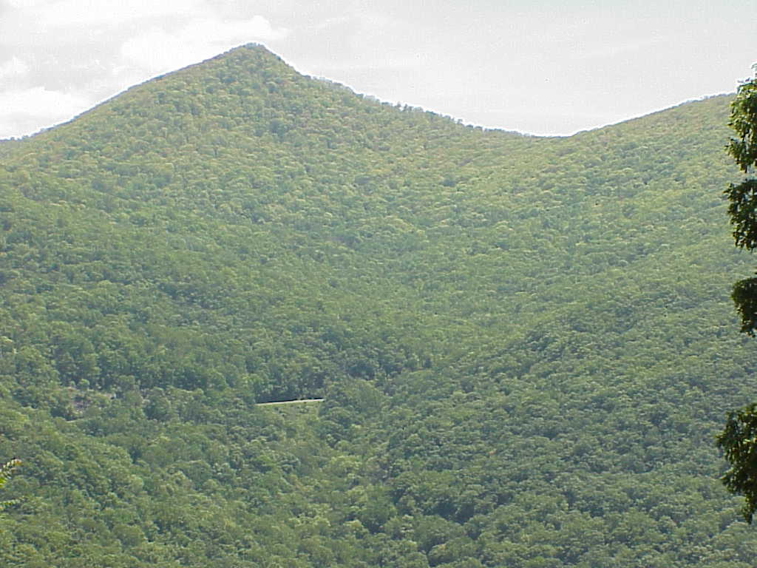
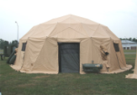
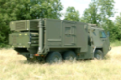
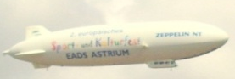
Global strategy
CSCC
Mission order
TOS
Transport
Operating base
Surveillance area
Maintenance base
… anywhere on the district…

Slide 5
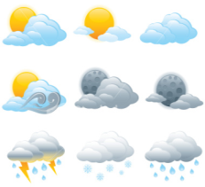
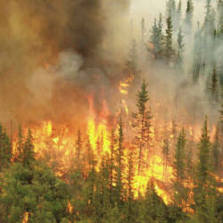
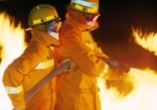
Global strategy
All weather conditions
CSCC
Height: 1km
Observation resolution: 1m/pixel
IR spectrum: 3.5µm to 7µm
IR observation
DataLink
Visible observation
3km
Fire
100 Km
3km
Speed & direction propagation
10km
Fire fighters
Operating base
Surveillance area

